Slide 1
4th Year IoT Project Aquarium Monitoring System: HCFF
Mettre futur logo
Julien Rose, Achille Bayart, Nicolas Rigaudy

Slide 2
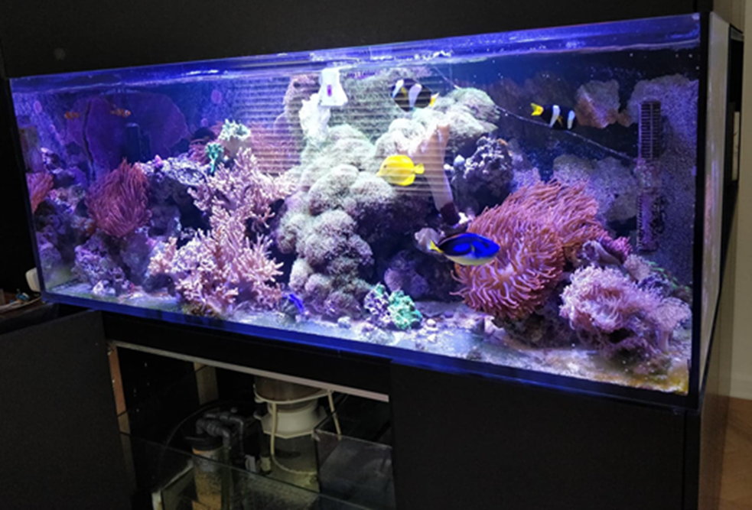
Introduction and context
Aim of the project ?
Working on a seawater aquarium which is composed of many fishes species

Slide 3
Introduction and context
Level of water
Viewer
Norm
Fish
Aquarium or Bassin
Camera
APP
Energie
Lights
Temperature
 | Fonctions de services principales et de contraintes de l’aquarium ou bassin
FP1 | Check the visual information the fish health.
FP2 | Show the information of the aquarium for the viewer.
FC1 | Monitor the level of water.
FC2 | Respect the aquatic bassin and user data norms.
FC5 | Use the energy available
FC3 | Automatically adjust the water temperature around a reference value
FC4 | Automatically adjust the lighting in function of the outside brightness

Slide 4
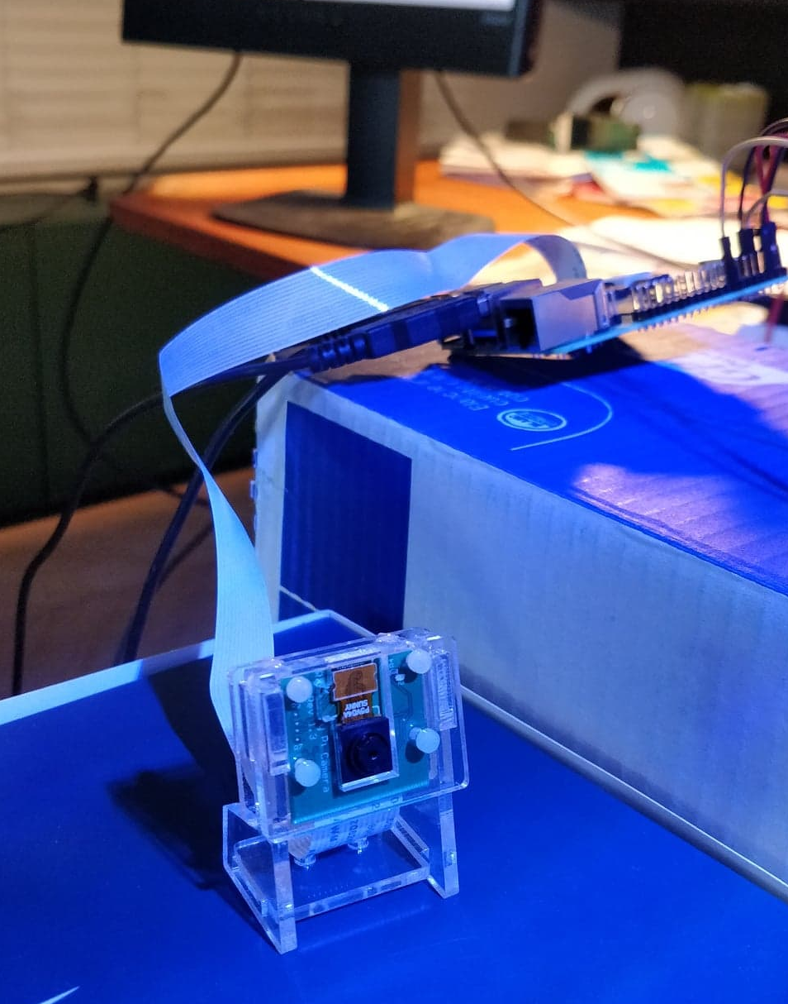
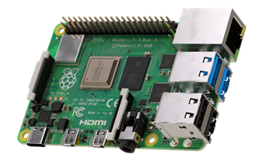
Completed work - Hardware
Raspberry Pi
Raspberry Pi 4 model B
Camera module B01

Slide 5
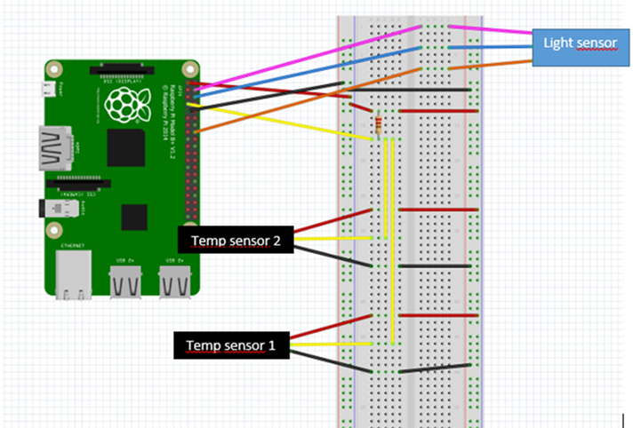
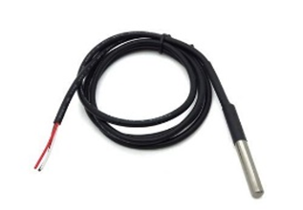
Completed work - Hardware
Temperature
DS18B20 sensor
The connection diagram (made on Fritzing)

Slide 6
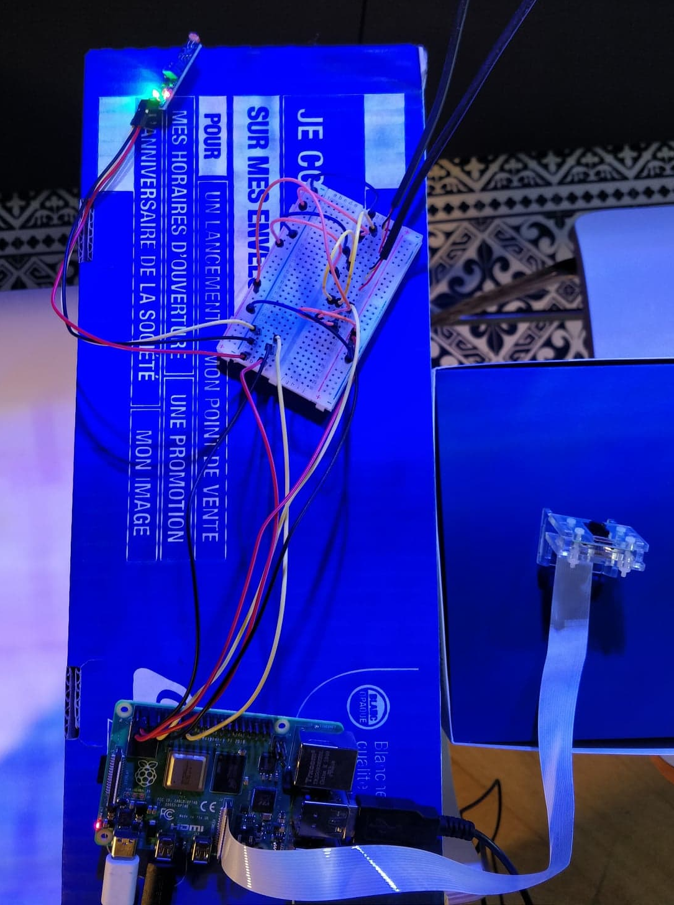
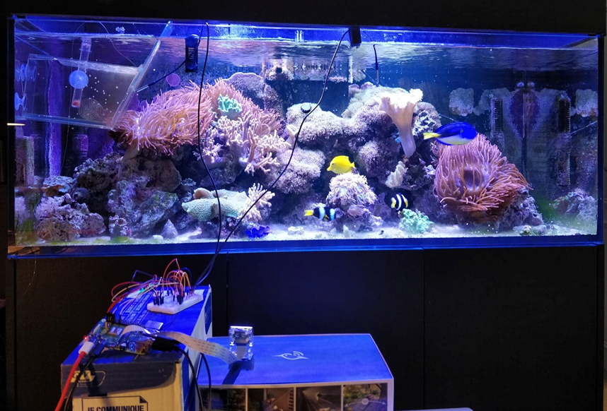
Completed work - Hardware
Temperature
The set-up during the test

Slide 7
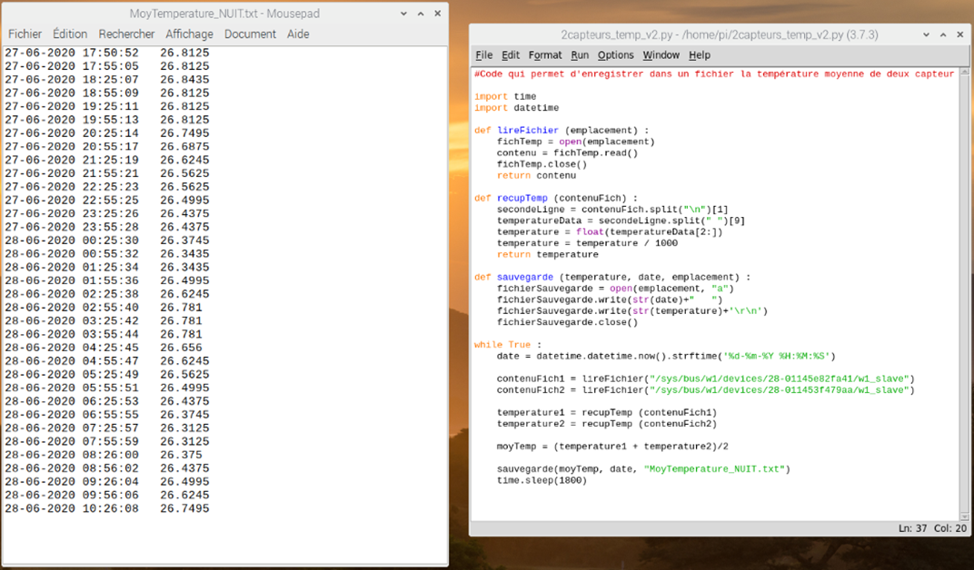
Completed work - Hardware
Temperature
Python code which saves the average temperature every 30min in a text file

Slide 8
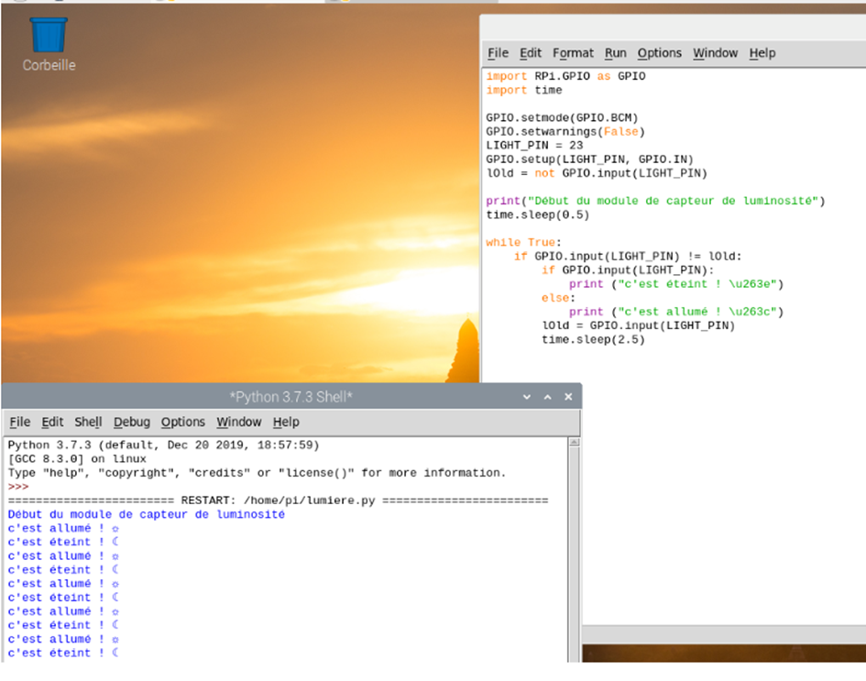
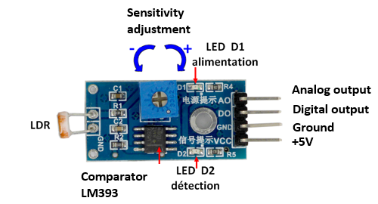
Completed work - Hardware
Brightness
Light sensor module
Brightness sensor Python code

Slide 9
Completed work - Image Recognition
Initial Idea

Slide 10
Completed work - Image Recognition
OpenCv

Slide 11
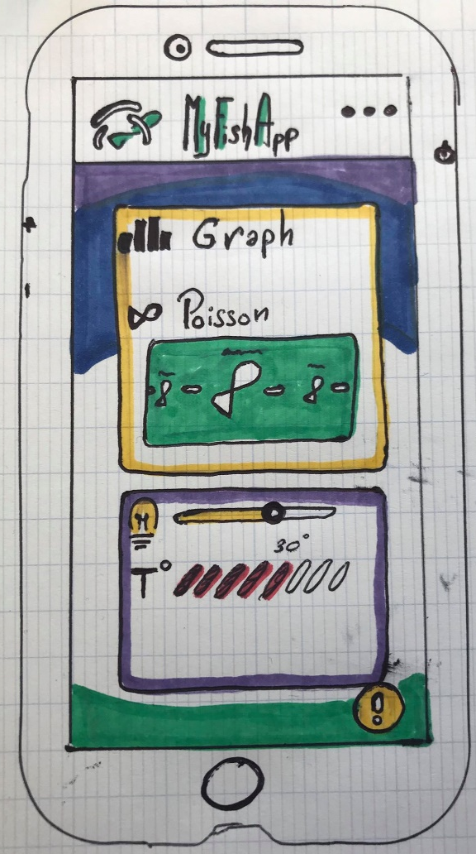
Completed work - Android App
Schematisation:
Meets the Needs:
FP1 : Check the visual information of health of the fish.
FP2 : Show the information of the aquarium for the viewer.
FC1: Monitor the level of water
That Should be:
Entertaining
Intuitive
Smart interface

Slide 12
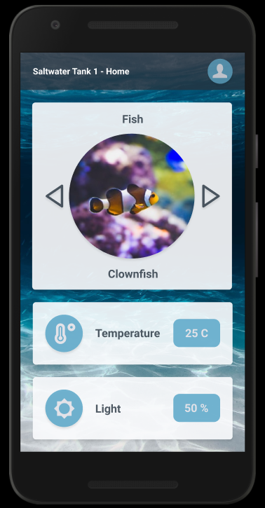
Completed work - Android App
Figma :
Prototype our ideas.
Simplify the way between drawing
and code.
Add code to see how to create
interface.
Entertainment part
Main information of the Aquarium

Slide 13

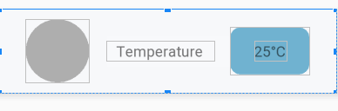
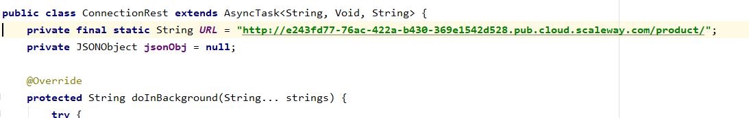
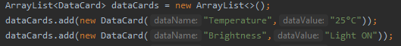
Completed work - Android App
Android Studio
CARD VIEW
CONNECTIVITY

Slide 14
Completed work - Data collection and linking
Rest Client

Slide 15
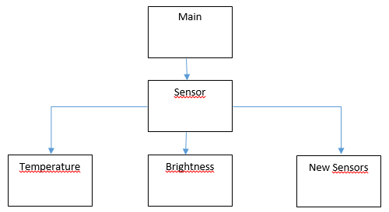
Project perspective
Planned additions
Challenges
How we would like to improve the Python code for the sensors.

Slide 16
Conclusion

Slide 17

Thanks for listening
And see you in september!

